Slide 1

Alberta Intercollegiate Sales and Marketing Competition
2026
Competitor Information
Updated August 11, 2026

Slide 2
Overview

Slide 3
Who are we?
The Alberta Inter-Collegiate Sales & Marketing Competition is Western Canada’s premier platform for challenging and showcasing Alberta students’ sales and marketing skills, where they experience authentic competitive challenges; and make meaningful industry connections.
This competition will emerge as a respected, effective catalyst for personal, academic and professional growth for post- secondary students in Western Canada.

Slide 4
Goals
To create an engaging and competitive environment that unites post secondary students across Alberta in sales and marketing challenges.
By collaborating with industry partners and presenting real-world scenarios, we aim to enhance student learning, strengthen industry relationships, and become a hub for talent development and academic innovation.
Industry partners, in turn, will use our competition as a
means to identify, then recruit sales and marketing
talent.
Competitors utilize AISMC presentation video in their social media and job search.

Slide 5

Competition Format

Slide 6
Competition Format
Prize Money: 1st-$5,000
1 day- March 7, 2025 (Saturday).
Student competitors recruited from 75+ post-secondary institutions in Western Canada.
Need to be current students, but necessarily in a business program.
No entry fee.
“No school west of Ontario is doing this!”
- Terry Peddlesden (Durham College)

Slide 7
Invitations (Schools)
Ambrose University
Athabasca University
Berman University
Bow Valley College
Concordia University
Grant MacEwan
University
Keyano College
Lakeland College
Lethbridge Polytechnic
Medicine Hat College
Mount Royal University
NAIT Polytechnic
NorQuest College
Northwest Polytechnic
Olds College
Portage College
Red Deer Polytechnic
SAIT Polytechnic
St. Mary's University
The King's University
U of A- Augustana
Campus
University of Alberta
University of Calgary
University of Lethbridge

Slide 8
Networking Reception March 6

Slide 9
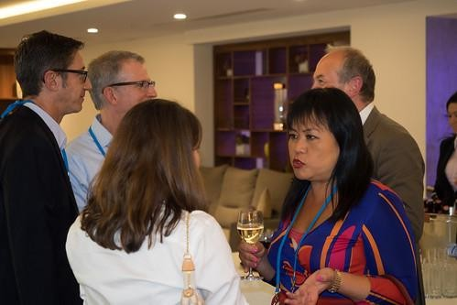
Networking Reception March 6
Attendees
Industry Guests (20)
Student Competitors (50- 60)
Instructors / Coaches
Sponsors (8)
Business Faculty Representatives (40)

Slide 10
Marketing Day March 7

Slide 11

Marketing Day- March 7
Open to 24 teams of 1 to 2 members
4 Agency side judges, 4 client side judges
Proposed Agenda
  8:00 – 9:30 AM
    Breakfast -Reception
  9:30 – 10:00 AM
    Opening Remarks- CMA Guest Speaker
  12:00 – 1:00 PM Lunch
    (informal, does not interrupt competition
flow)
  10:00 AM – 5:30 PM
    Competition
  6:00 PM
    Closing Remarks and Awards

Slide 12
Sales Day March 7

Slide 13

Sales Day- March 7
Open to 24 pre-qualified competitors
No academic judges, sponsor judges only (4)
Proposed Agenda
  8:00- 9:30
    Breakfast Reception
  9:30 – 10:00 AM
    Opening Remarks- CPSA Guest Speaker
  12:00 – 1:00 PM Lunch
    (informal, does not interrupt competition
flow)
  9:00 AM – 5:15 PM
    Competition
  5:30 – 6:00 PM
    Closing Remarks and Awards

Slide 14
Step by Step

Slide 15
1. Choose Your Competition and Gather Your Team
Marketing Competition: Assemble a team of one to two students to collaborate on tackling business challenges.
Sales Competition: Compete individually to showcase your product-pitching skills.
Make sure everyone on your team is enrolled in an Alberta post-secondary institution.
PLEASE NOTE: You may enter both competitions.

Slide 16
2. Prepare Your Screening Video
Marketing Competition: Create a 1-5 minute video describing the business problems and opportunities based on the provided marketing case below.
Sales Competition: Submit a 30-90 second video pitching a product of your choice with persuasive and creative sales techniques.
Upload your video to a platform like YouTube or Vimeo and generate a shareable URL.

Slide 17
3. Register and Submit Your Screening Video
Complete the registration form and include your screening video’s URL. The deadline to submit your screening video is March 4, 2026. Don’t miss out!
Marketing Competition: Both students must fill out the registration form individually, but have the same URL link, and the same team name.

Slide 18
4. Participate in the Screening Round
Your video will be evaluated by a panel of judges. Top- performing teams (for Marketing) and individuals (for Sales) will be selected to advance to the finals.

Slide 19
5. Compete in the Finals
Marketing Finals: The top 12 teams of one to two will compete in Calgary for a $5,000 cash prize.
Sales Finals: The top 24 individuals will compete in Calgary for a $5,000 cash prize.
This is your chance to shine, connect with industry professionals, and potentially take home the prize!

Slide 20
How to sign up…
Marketing Teams: https://www.aismcompetition.ca/event- details/marketing-competition-registration
Sales Competitors: https://www.aismcompetition.ca/event-details/sales- competition-registration

